Slide 1
What are psychiatric/neurodegen disorders
  Include ipsc, culture, whole tissue
Definition of the problem
  Abundance of whole tissue data
Cell type tissue transition illustriated
Observation of cell death/prolif/inflamation in neurodege
  Some changes are cell type specific. Cell type loss or effect on a cell type
  Kinda like examining the whole brain vs studying specific regions
Research question
Limitations of known markers
Why our data
Why not human data

Slide 2
Psychiatric/Neurodegeneretive disorders
Bad things...
More bad things...
Many of them are associated with effects on single cell types

Slide 3
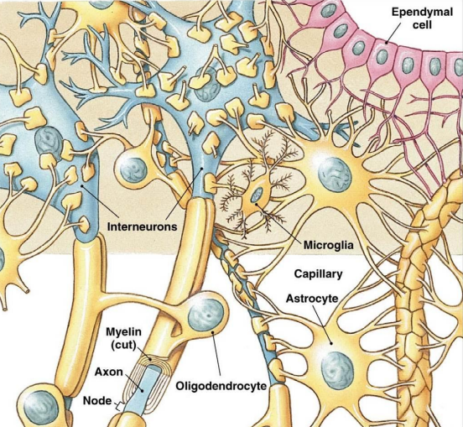
Studying psychiatric disorders
Cell cultures
  Isolate the cell type, work with it indefinetly
  Not easy for all cells. Cells needs friends
iPSC models
  Differentiate the cell type yourself
Single cell isolation
Whole tissue
  Easiest to perform
  Cell types are overrated
  General differential expression
  E.g. Allan brains
Notes:
Purkinje cells are hard to culture

Slide 4
What's wrong with those
iPSCs and cell cultures do not necesarilly behave the same as their in situ counterparts
Single cell isolation from healthy and diseased subjects require good animal models or lots of dead patients and money
Whole tissue has a dilution problem
  Expression changes in single cell types might not be detected easily
  Proliferation or cell death will not be detected

Slide 5
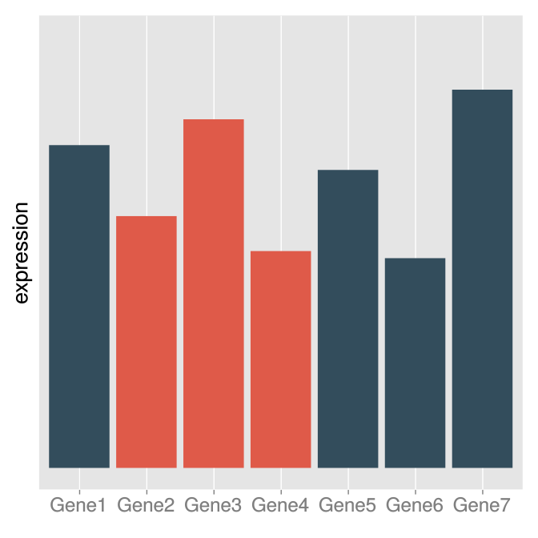
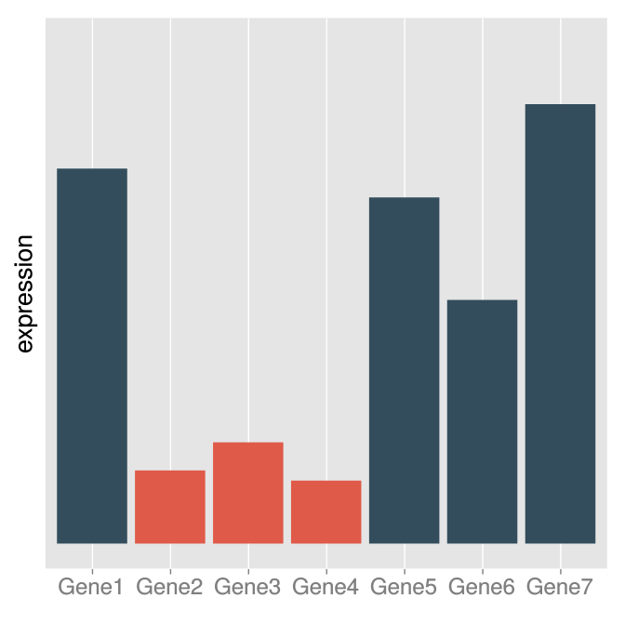
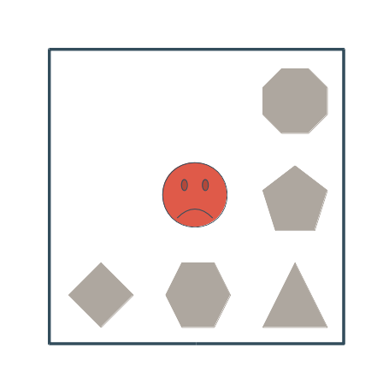
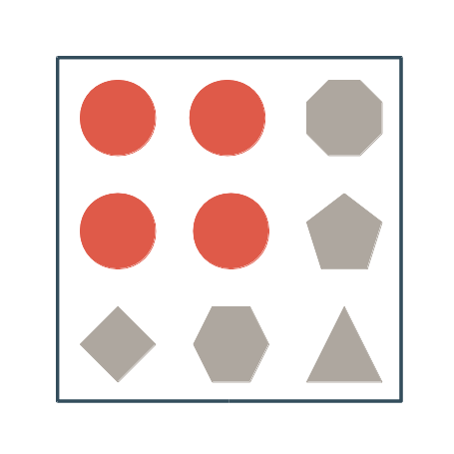
What we want
Make use of available whole tissue data to get cell type specific information
How would a cell type specific effect can be observed from overall gene expression
  Cell type specific genes!

Slide 6
How we do it
Assembly of an expression profile dataset gathered of cell type specific samples gathered from mouse brains.
Select cell type specific genes
Use the genes to make inferences about human tissue samples

Slide 7
Why...
don't we use human data
  We don't have any
  INSERT QC PLOT 'ERE
do we select new genes
  Known markers are few and not always present on the chips
  Some cell types are defined by morphology
  Having more genes increases our confidence

Slide 8
The data
Mouse cell type specific microarray data from (mostly) publicly available datasets
  Look for studies that isolated cells for any reason
  Get their control and/or wild type samples
  Make sure they are what the original researchers claim to be
    Check to see if they are actually expressing their markers
  Get mad when they are not

Slide 9
Selecting cell type specific genes
Generalize the names
  We don't have enough data to differentiate between every single subtype
Cell Type | Original Description
Spiny | Drd1a+ Medium Spiny Neurons
Spiny | Drd2+ Medium Spiny Neurons
Oligodendrocyte | Mature oligodendrocytes
Oligodendrocyte | Mixed oligodendrocytes
Table: A subset of the cell types used

Slide 10
Selecting cell type specific genes
Generalize the names
  We don't have enough data to differentiate between every single subtype
Assign cell types to prospective regions
Cell Type | Original Description | Region
Spiny | Drd1a+ Medium Spiny Neurons | Striatum
Spiny | Drd2+ Medium Spiny Neurons | Striatum
Oligodendrocyte | Mature oligodendrocytes | Cortex
Oligodendrocyte | Mixed oligodendrocytes | Cortex
Table: A subset of the cell types used

Slide 11
Selecting cell type specific genes
Generalize the names
  We don't have enough data to differentiate between every single subtype
Assign cell types to prospective regions
For glial cells that are known to be all around the brain place them to all regions that apply
Cell Type | Original Description | Region
Spiny | Drd1a+ Medium Spiny Neurons | Striatum
Spiny | Drd2+ Medium Spiny Neurons | Striatum
Oligodendrocyte | Mature oligodendrocytes | Cortex, Cerebrum
Oligodendrocyte | Mixed oligodendrocytes | Cortex, Cerebrum
Table: A subset of the cell types used

Slide 12
Selecting cell type specific genes
For every cell type in their prospective regions, choose genes if
  They have a 10 fold difference to the median expression in the region
  They form good clusters. (Silhouette)
  They don't satisfy these conditions for any other cell type in the region

Slide 13
Making use of our gene list
Switching to human data
  Cortex samples from bipolar and control samples from Allan brain institute
Assumption 1: Genes selected as marker genes in humans will also apply to human samples
Assumption 2: The main variation in the levels of these genes will be caused by differences in cell type counts.
Comparing the first principle component of marker gene expression between groups will inform us about the relative amount of a given cell type

Slide 14
Making use of our gene list
Insert graphs (repeat for gabaDeep too)

Slide 15
Problems with marker genes
We only get few markers for some cell types
Some of the markers found do not work with humans
Insert not working gene graph here

Slide 16
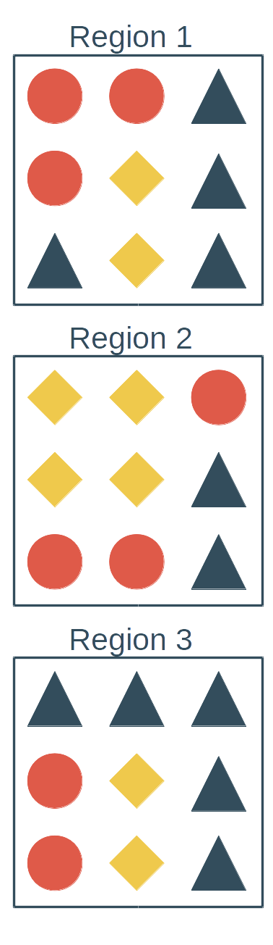
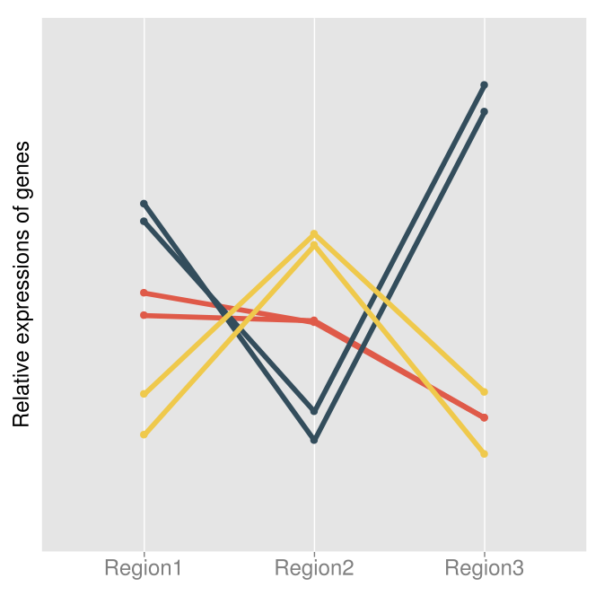
Expansion with coexpression
The genes that do work will be coexpressed

Slide 17
Expansion with coexpression
Create a coexpression network
Find the largest family or use a well known marker to guide the selection
Add new human genes that are connected the family as marker genes
Remove genes that are not connected to the family

Slide 18
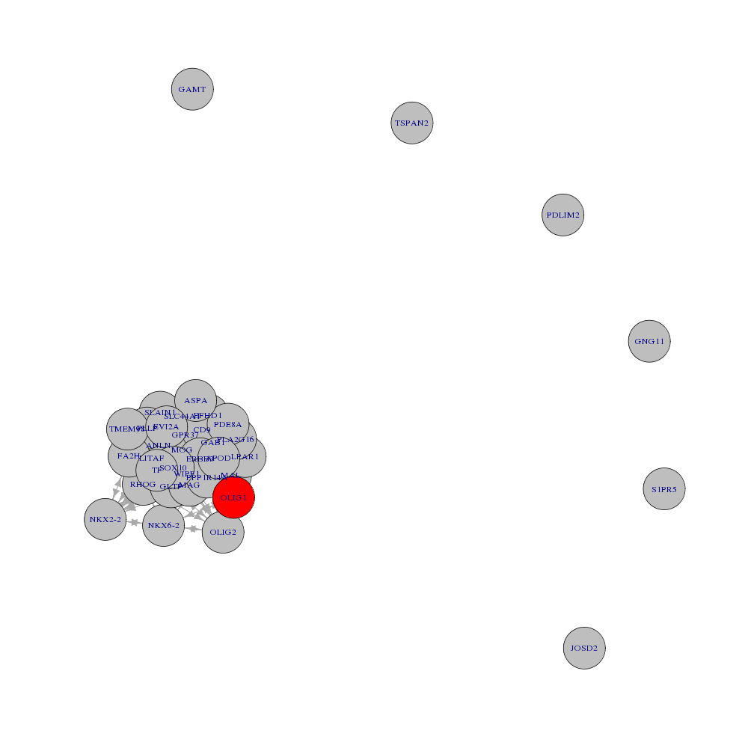
Expansion with coexpression
Coexpression network for oligodendrocyte markers

Slide 19
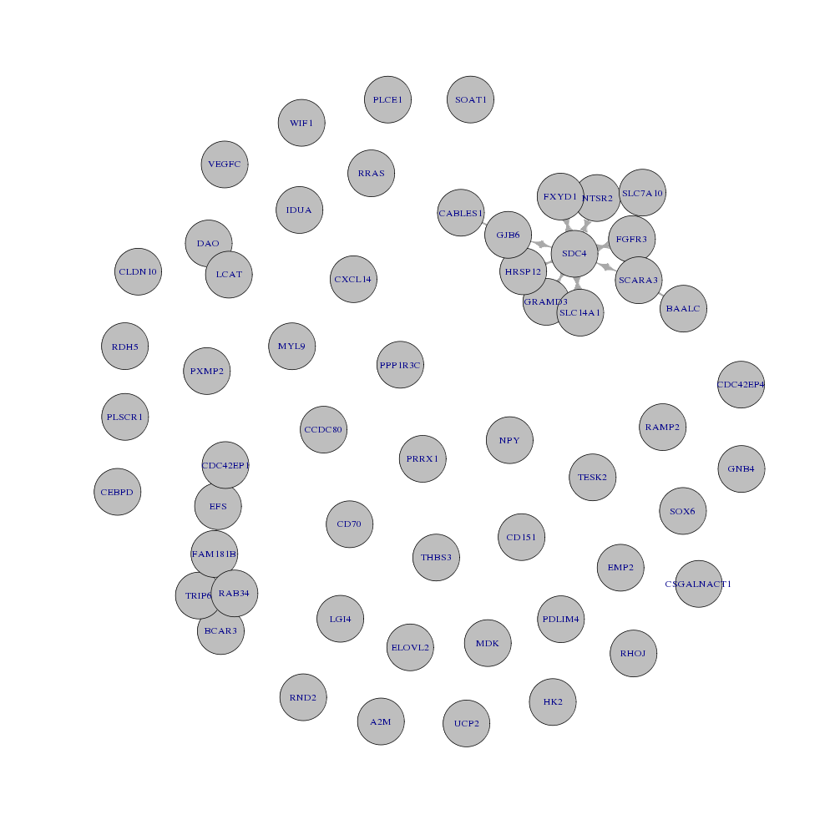
Expansion with coexpression
Coexpression network for bergmann glia

Slide 20
I am unsure if I should add new gene addition confirmation here since this is getting too long

Slide 21
Future prospects
Verification of human genes
Finding a good metric of trusted human genes
Enrichment of coexpression with functional groups in neurological diseases

Slide 22
Acknowledgments
CIHR funds
Lil(y)a(c)(h) guides
Paul supervises
Shreejoy stops by every once in a while

